Slide 1
Face Detection
PYTHON PROJECT
PR ATYU SH K U M AR SAH O O
21052685@ kiit.ac.in

Slide 2


Slide 3
CONTENT
Introduction
Motivation
Innovation of Project
Scope of the Project
Face Detection
Conclusion
References

Slide 4
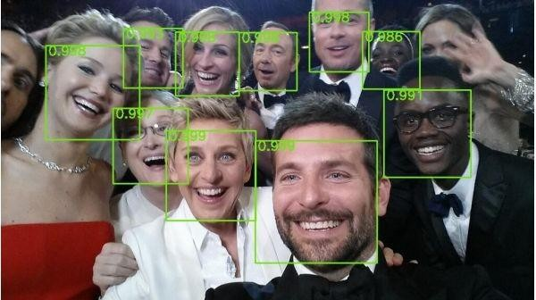
In troduction
Face detection is a computer vision technology that helps to locate/visualize human faces in digital images. This technique is a speciﬁc use case of object detection technology that deals with detecting instances of semantic objects of a certain class (such as humans, buildings or cars) in digital images and videos. With the advent of technology, face detection has gained a lot of importance especially in ﬁelds like photography, security, and marketing.

Slide 5
Motivation
We developed this Face Detection Project for our Indian Army, Security CCTV Police and even Common Use of people to detect Face in single and group of peoples in Images.
Today In world Security is advancing to detect the terrorist and criminals easily in crowd. This Project will easily detect faces even old\blur Images with very less time of execution.
This Face Detection Code can be deployed and use in any application camera, security apps and website to found faces easily.

Slide 6
Innovation Idea of Project
It can Detect faces easily with less time of execution.
It can Detect Face in any quality of Images even blur.
It can Detect single, double or even multiple faces in any Image.
It can tell the number of Peoples/faces in Image.
It is fully automatic face recognition system
It is one of the best in today world Innovation as per less number of code use in the system.
It use Haar feature based Algorithm to detect which it makes very accurate andfast processing of face detection

Slide 7
SCOPE OF PROJECT:-
To identify and verify terrorists at airports, railway stations and malls the face recognition technology will be the best choice in India as compared with other biometric technologies since other technologies cannot be helpful in crowded places.
This technology can also be used effectively in various important examinations such as SSC, HSC, Medical,
Engineering, MCA, MBA, B- Pharmacy, Nursing courses etc. The examinee can be identified and verified using Face Recognition Technique.
It can also be deployed in police station to identify and verify the criminals.
To Identify the Number of student in classroom. It can collect in all the number of faces in less than 1 sec. Easy to take attendance.
FACE DETECTION:-
Face detection is a technique that identifies or locates human faces in digital images. A typical example of face detection occurs when we take photographs through our smartphones, and it instantly detects faces in the picture. Face detection is different from Face recognition. Face detection detects merely the presence of faces in an image while facial recognition involves identifying whose face it is. In this article, we shall only be dealing with the former. Face recognition is the task of identifying an already detected object as a known or unknown face. Often the problem of face recognition is confused with the problem of face detection Face Recognition on the other hand is to decide if the "face" is someone known, or unknown, using for this purpose a database of faces in order to validate this input face.

Slide 8
FACE DETECTION CLASSIFIER:-
Face detection is performed by using classifiers. A classifier is essentially an algorithm that decides whether a given image is positive(face) or negative(not a face). A classifier needs to be trained on thousands of images with and without faces. Fortunately, OpenCV already has two pre-trained face detection classifiers, which can readily be used in a program. The two classifiers are:
Haar Classifier and
Local Binary Pattern (LBP)
For this Project, Will only discuss the Haar Classifier for Face Detection as it best method for detection.
CONCLUSION:-
Face recognition technologies have been associated generally with very costly top secure applications. Today the core technologies have evolved and the cost of equipments is going down dramatically due to the integration and the increasing processing power. Certain applications of face recognition technology are now cost effective, reliable and highly accurate. As a result there are no technological or financial barriers for stepping from the pilot project to widespread deployment.
Government and NGO’s should concentrate and promote applications of facial recognition system in India in various fields by giving economical support and appreciation.

Slide 9
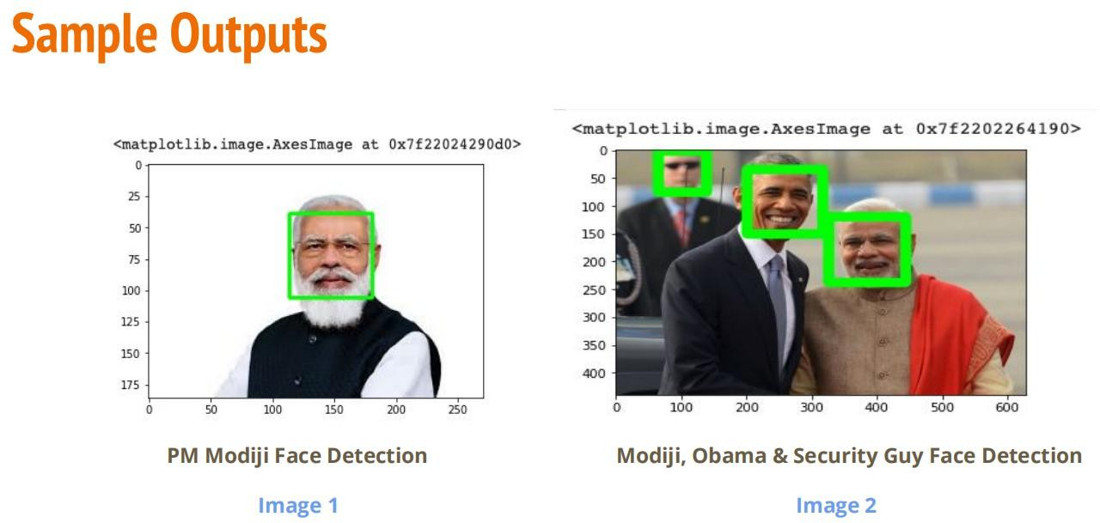
NAME- PRATYUSH KUMAR SAHOO ROLLNO-21052685
SECTION-DA-5

